Slide 1
Utility Rate Overview
City of Bethany City Council Meeting
August 1st, 2023
Information for Initial Discussion

Slide 2
This presentation is designed to “get the ball rolling” on a conversation about raising rates.
The actual details of what capital projects need to be considered, the financing of those projects, and the amount of rate increases for the needed revenue will be discussed at future meetings.
Municipal Finance Services will conduct calculations of different rate and financing scenarios and present their findings.

Slide 3
Utility Rate Changes-
How did we get here?

Slide 4
March 2020 – City Engineer presents Utility Cost Analysis
City Manager presents $30 increase per account
City Council Adopts $30 increase
April 2020 - $30 Increase takes effect
City Council reduces increase to $16 per account
May 2020 - $16 Increase takes effect

Slide 5
Bethany Utility Services Minimum Amounts effective 5-1-2020
Previous Amt Increase Current Amt
Water 12.49 5.33 17.82
Sewer 10.46 5.33 15.79
Trash 16.60 5.34 21.94
Total 39.55 16.00 55.55
Note: Stormwater fees and EMS Services are additional fees.

Slide 6
Bethany Utility Rates for Average User
(5000 Gallon Water Usage & 2 Polycarts)
Previous Amt. Cost Study Current Amt.
Break Even*
Water 25.49 30.85 30.82
Sewer 21.31 25.67 26.64
Trash 19.10 18.76 24.44
Total 65.90 75.28 81.90
*Does not include General Fund Subsidy

Slide 7
City Cost Comparisons for Average User
Including Misc. Fees
Difference
Bethany 87.50 --
Yukon 88.64 1.14
Mustang 101.11 13.61
OKC 97.41 9.91
Piedmont 103.90 16.40
Midwest City 78.48 -9.02
El Reno 96.97 9.47
Edmond 121.01 33.51

Slide 8
Automatic Escalators
Mustang has an annual 2% or CIP increase, whichever is greater.
Oklahoma City has a 10% annual increase in per 1000 gallon water rates through 2026.
Edmond has been raising water and sewer rates every year for the past 5 years. The rate was raised 5% from 2022 to 2023.
Oklahoma City’s escalator varies by water usage, but the average user will see about a 4% increase per year.
Yukon does not have an automatic escalator, but bills include a $20 OKC water subsidy fee
Piedmont bills include a $7 Capital Improvement Fee

Slide 9
How are Utility Rates Calculated?
Operational Costs
Debt Service
Capital Improvements
Subsidy to City Operations

Slide 10
PWA Operating Costs and Debt Service
Per 2024 Budget
Administration & Finance $ 712,100
Sanitation 2,169,976
Water Plant 2,167,158
Water Line 484,500
Sewer Line & Treatment 2,232,400
Fleet Maintenance 133,624
Contingency 250,000
Debt Service 1,365,000
$9,514,658

Slide 11
Capital Improvements
TEIM Design has produced a very preliminary 5 year Capital Improvement Plan which would call for continued investment in rehabilitating our Sanitary Sewer system, as well as Replacing aging water lines. These items would total $ 875,000, as well as costs to replace the aging water meters with new automatic meters are expected to total $4,825,000 (not including the $1,500,000 matching ARPA grant project currently scheduled). This would result in a minimum Capital Improvement annual investment of $1,140,000 for the next 5 years.
General Obligation Bonds are generally not used for Utility improvements, as rates are designed to pay for these items. The burden of paying for GO Bonds rests solely with the property owner, whereas rate increases are spread throughout the population.

Slide 12
Historical General Fund Transfer Amounts
FY 2020 $ 2,200,000
FY 2021 $ 1,782,014
FY 2022 $ 2,599,875
FY 2023 $ 2,515,470
FY 2024* $ 2,150,000
Average $ 2,249,472
*Budgeted

Slide 13
Total Annual Costs
Operating and Debt Service $ 9,514,658
Avg. Transfer to General Fund $ 2,249,472
Capital Improvements $ 1,140,000
Total $12,904,130
Current Annual Income $10,499,454
Shortfall $ 2,404,676

Slide 14
Other Considerations

Slide 15
Bethany has approximately 7,000 water meters, the majority of which are 20+ years old. Aging water meters tend to slow down and even completely stop reading water consumption. We have identified at least 225 water meters that are likely “dead” meters.
Cities who have replaced their aging meters have reported as much as a 15% increase in the amount of water billed. In Bethany’s case this could result in an increase of water revenue of $600,000.

Slide 16

Costs shown based on FY 24 estimates. The costs of hiring and retaining employees have risen dramatically, as well as costs of utilities, fuel, chemicals and many other budgetary items. Annual inflation will need to be considered when making any future cost projections.
The five-year capital improvement plan is strictly preliminary and still does not address some major issues that may need to be addressed through future grants, increased rates or OWRB loans.
The Bethany-Warr Acres Public Works Authority is expected to raise the rates it charges the cities for sewer treatment. It is unknown at this time how much that increase will be, but it’s expected to be significant.

Slide 17
Options for Raising Rates

Slide 18
When rates were raised in 2020, each base rate for water, sewer and sanitation was raised $5.33 to make up the $16 per citizen increase adopted by the Council. This was an easy adjustment to make, however not the only option and did not account for the needs of the future.

Slide 19
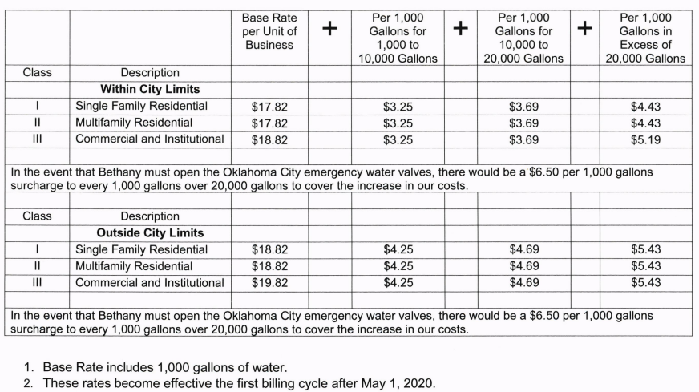
The City of Bethany has a 4-tier water rate structure. The base rate which includes 1000 gallons of water, the next 9000 gallons, then the next 10,000 gallons, and then consumption above 20,000 gallons. Any of these rates can be adjusted individually. Also, we have three classifications – residential, multifamily residential and commercial. Any of these can be adjusted as well.

Slide 20

If the Council wishes to minimize the impact on elderly and low-income households (which typically use less water) the base rate could be minimally adjusted, and the higher consumption tiers could be adjusted to compensate.
Sewer rates have a similar tiered structure, and therefore could be adjusted accordingly.
As mentioned, Municipal Finance Services will be giving a more detailed presentation on specific financing and rate options.

